Slide 1
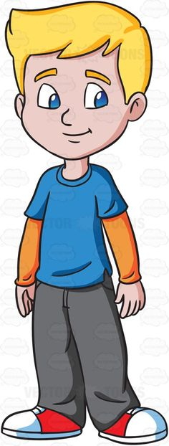
Hello children!
This is Robin Scott. Where’s he from?

Slide 2
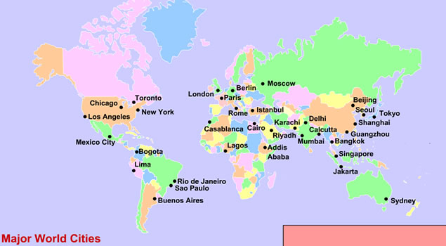
Where is London?

Slide 3
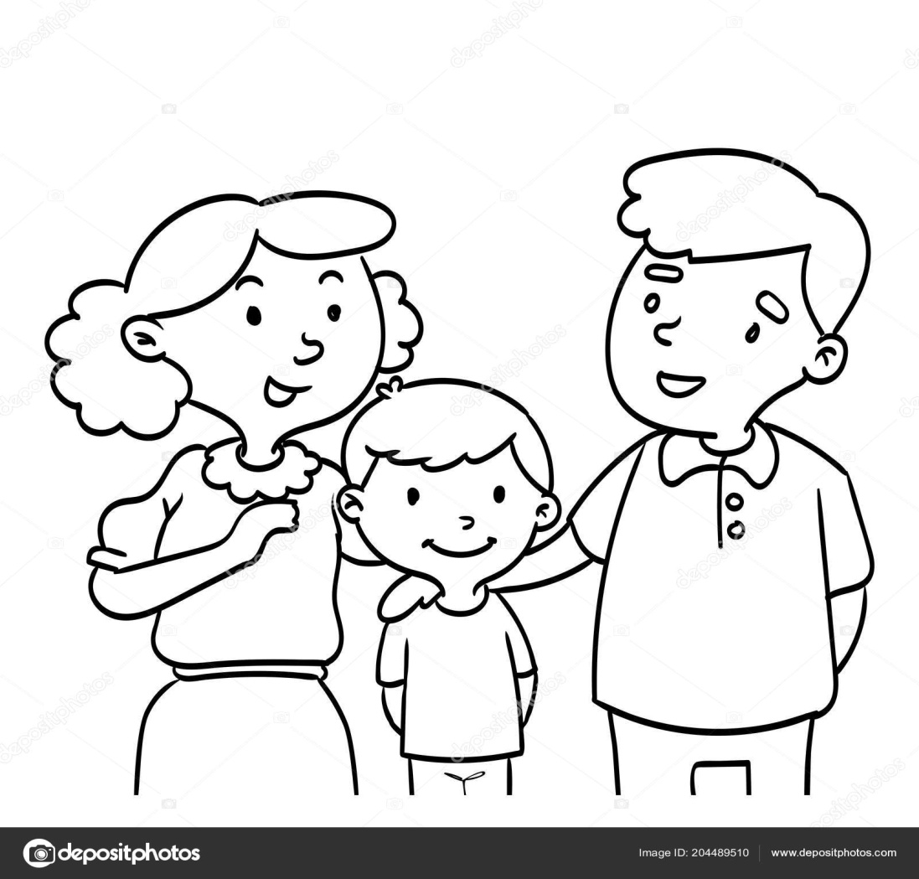
Let’s meet his family.

Slide 4
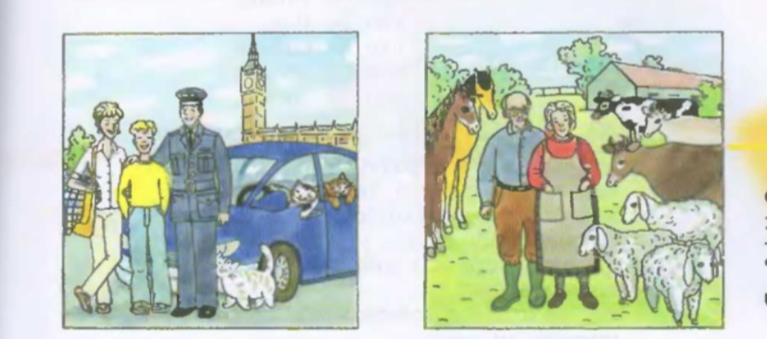
Read the text
Robin Scott is a schoolboy. He is from London. He is twelve. He has parents and grandparents. His parents are young. His father is a pilot. He is big and strong. He has a big a new car. It is bright blue. It is a very good car. His mother is nice. She is thin but she is not weak. She has three fat cats. They are her pets. Her father and mother are not in London. They are on the farm. They have horses, cows, and sheep on the farm. He can feed the animals.

Slide 5
How old is Robin?
11
12
13

Slide 6
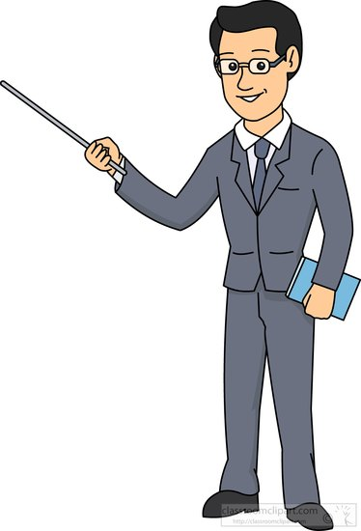
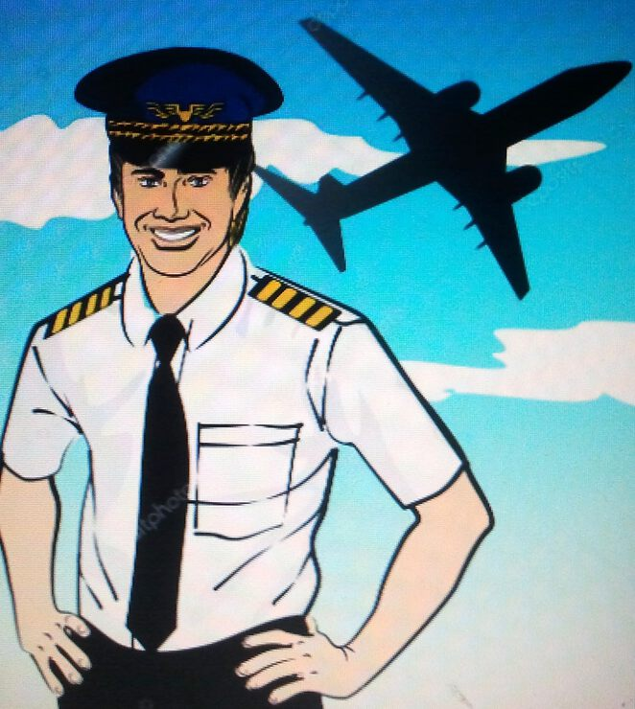
Who’s Robin’s father?
He is a doctor
He is a teacher
He is a pilot

Slide 7
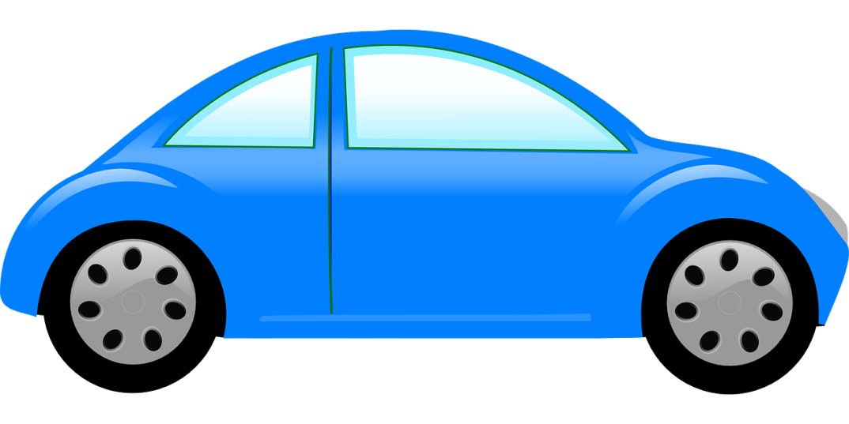
What color is his car?

Slide 8
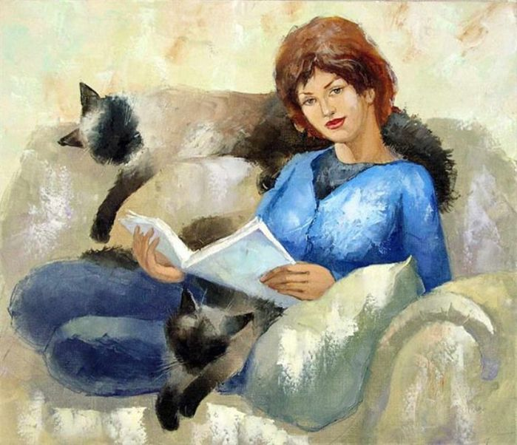
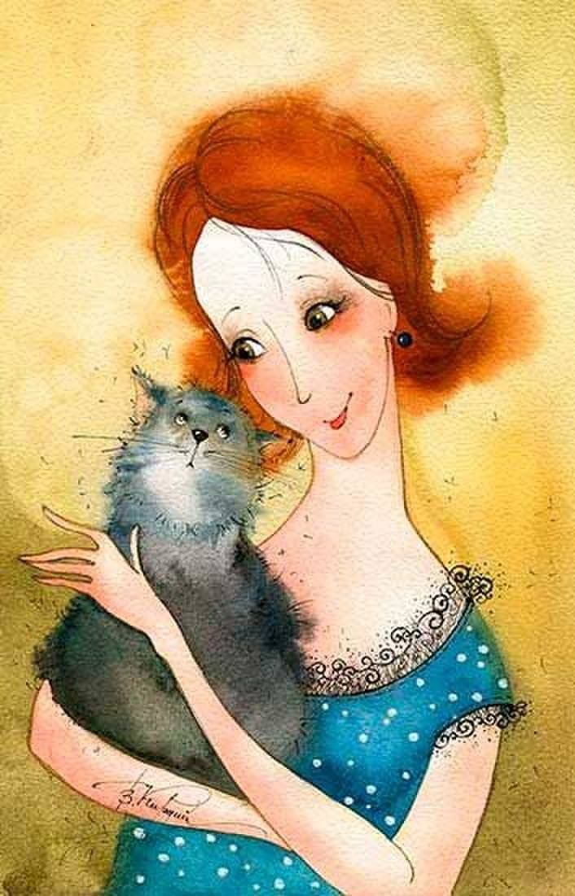
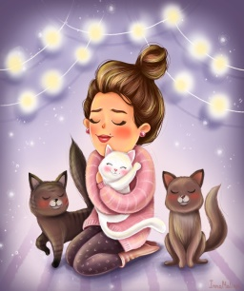
How many cats does Robin’s mother have?
a. 1
b. 2
c. 3

Slide 9
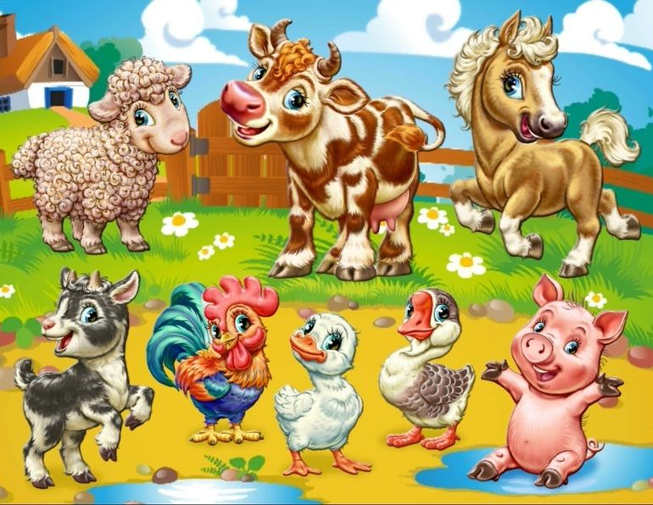
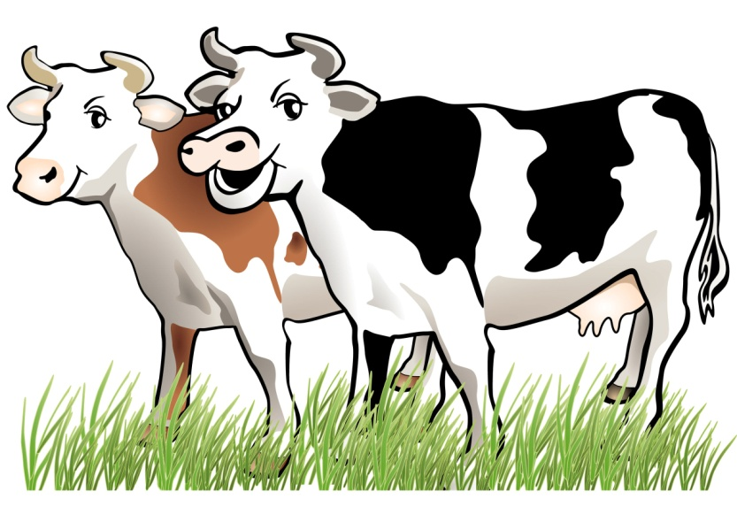
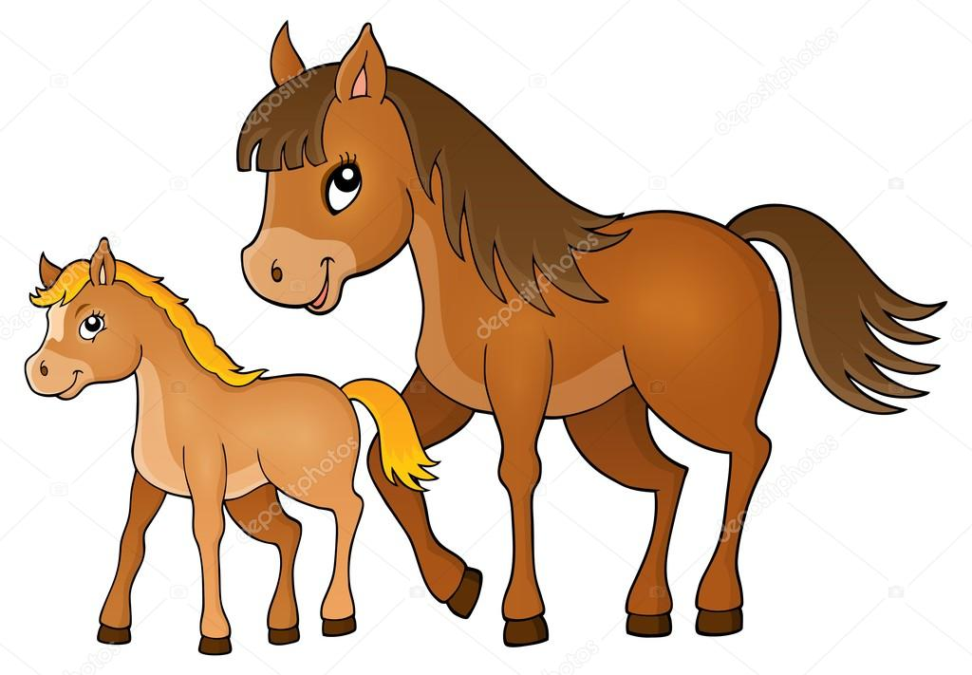
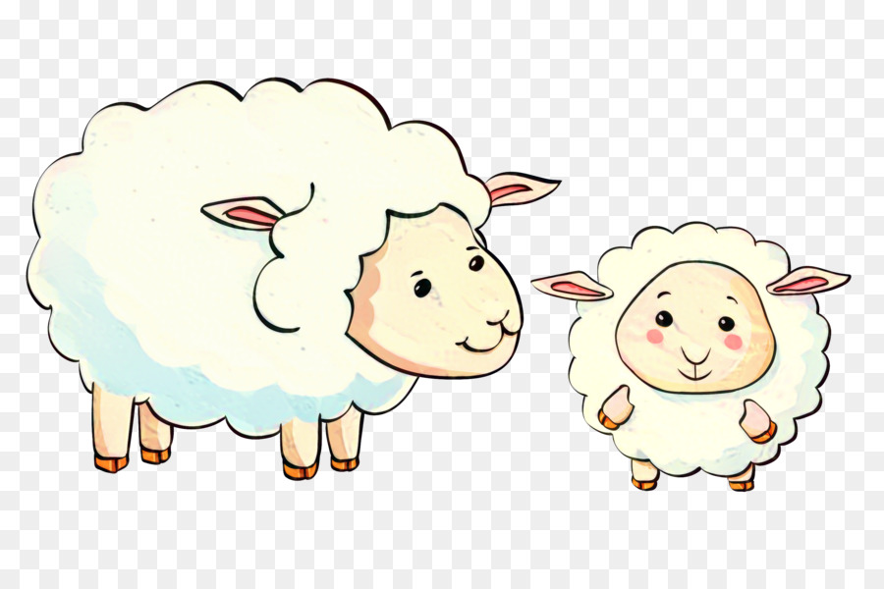
What animals live at grandparents?

Slide 10
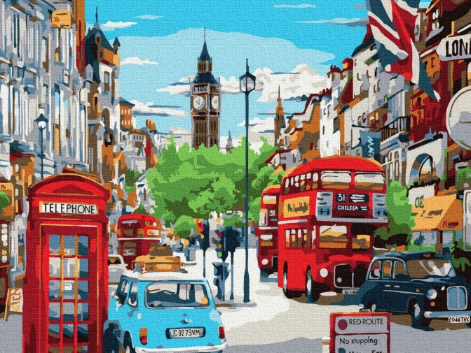
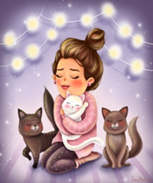
Tell me about Robin's family.

Slide 11
Robin’s family are happy to meet you
Goodbye!

